Slide 1
The Agile way with PMI® ACP?
Edureka is a Global Registered Education Provider (R.E.P ID : 4021) from Project Management Institute (PMI®)

Slide 2
Know Your Instructor
18 years of experience in Software Development
Have been exposed to Agile Engineering Practices for over 15 years.
One of the implementers of TataSky, Airtel and many other digital broadcast solutions in India and worldwide.
Currently engaged in consulting and training in the areas of
TDD/ATTD
Emerging Design and Code Refactoring
API Design
Programming Languages: Java, C++, Python.
Software Design: Using patterns, SOLID principles

Slide 3
Objectives
The Agenda for the day:
Agile Manifesto & Principles
About PMI-ACP Exam
How PMI-ACP® certification will help?
Eligibility Requirements
Application Process
How can Edureka help you?

Slide 4
Agile Manifesto
Individuals and interactions over processes and tools
Working software over comprehensive documentation
Customer collaboration over contract negotiation
Responding to change over following a plan
Coutesy: http://www.agilemanifesto.org/

Slide 5
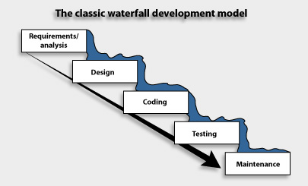
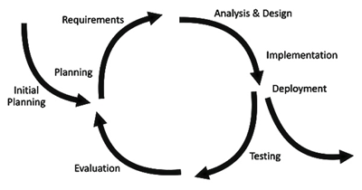
Agile Principles
Classic Waterfall
Iterative Development
Tries to eliminate uncertainty by planning upfront.
Embraces uncertainty with short iterations.
Consequence: Inspect and Adapt.

Slide 6
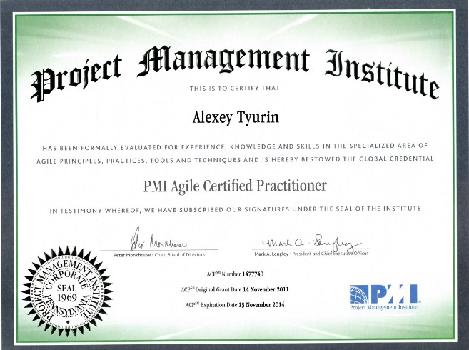
About PMI-ACP® Exam
PMI-ACP® exam is based on the following:
12 recommended books from PMI® known as “Reference Materials” (https://www.pmi.org/~/media/PDF/Certifications/ACP_Reference_list_v2.ashx)
Once certified, the ACP certification is valid for 3 years
To continue to hold the PMI-ACP® certification, at the end of the 3 year certification cycle, one needs 30 PDU’s
PDU stands for Professional Development Unit
1 PDU corresponds to 1 hour of professional development activity
http://atyurin.com/2012/03/13/PMI® -certificates/

Slide 7
How will PMI-ACP® Certification Help?
Certified Agile Practitioner will be able to:
understand the various aspects of implementing Agile in the organization
give structure to Agile body of knowledge to meet their needs
handle Agile Projects more effectively
build on the confidence of customers
more rigour
http://atyurin.com/2012/03/13/PMI® -certificates/

Slide 8
PMI-ACP Eligibility Requirements
Requirement | Description
Educational Background | Secondary degree (high school diploma), associate’s degree or global equivalent
General Project Experience | 2000 hours (12 months) working on project Teams, must be earned in the last 5 years
Agile Project Experience | 1500 hours (8 months) working on project teams using Agile methodology Must have earned this in the last 3 years These hours are in addition to the 2000 hours of general project experience
Training in Agile Practices | 21 contact hours (In Agile Practices)

Slide 9
Exam Application Process
Application can be submitted via online or in a paper based mode Online Processing Time – 5 business days Paper based Processing Time – 10 to 20 days
Once application is reviewed for completeness, payment for the exam is done
After payment is made, PMI sends an electronic notification indicating - Examination Scheduling Instructions - or – the Application is selected for audit
Exam should be taken within 1 year of date of registration - Conducted via Prometric worldwide.

Slide 10






How it works with edureka!
LIVE and Interactive Online Classes
Flexibility to re-attend or re-schedule the class
Lifetime Access to the Class Recordings in Learning Management System (LMS)
Module Wise Quizzes
24x7 on – Demand Technical Support
Post Course Support
21 Contact Hours Certificate
Assistance in Filling the Application Form
Hundred’s of People trained in PMI-ACP®
More than 2,00,000
Learners Across the Globe
PMI-ACP® Success
Ratio of 97%

Slide 11
Edureka PMI-ACP Course Topics
Module 1
Introduction to PMI-ACP®
Module 2
Agile Project Management Framework
Module 3
Agile planning, Monitoring and Adapting
Module 4
Agile Estimation
Module 5
Agile Analysis & Design
Module 6
Communication
Module 7
Product Quality
Module 8
Soft Skills Negotiation
Module 9
Value Based Prioritization
Module 10
Risk Management
Module 11
Metrics
Module 12
Value Stream Analysis
Module 13
Knowledge and Skills

Slide 12
Important Links
The PMI-ACP homepage, https://www.pmi.org/certification/agile-management-acp.aspx
Check out the download-able PDF handbook, exam guide and reference list.

